Slide 1
Group 6 Dillama
Presentation 2
Notes:
Everyone

Slide 2
The Brief
2D
Tap input
Turn-based single-device multiplayer
Symmetric level design
Easy to learn game yet hard to master
Notes:
Tom
Input is single instant of contact.
Local multiplayer – adversarial. Asynchronous player turns.
Symmetric – players have access to the same knowledge and equal opportunity regarding input effect.

Slide 3
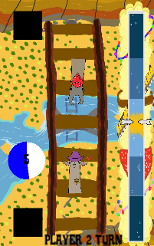
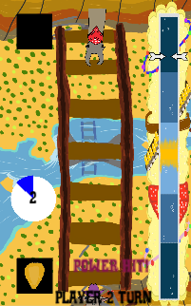
What is our Game?
Timed tap
Asynchronous, turn based
Symmetrical, first turn
Time, tap, progress
Win/loose condition
Notes:
Tom

Slide 4
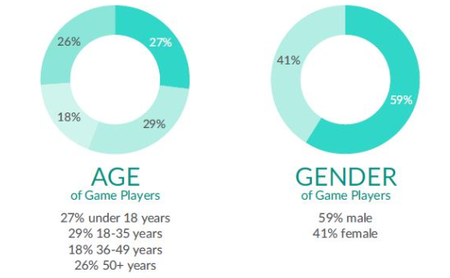
Target Audience
Casual mobile gamers
14 – 35 year old males
Source: https://ukie.org.uk/sites/default/files/UK%20Games%20Industry%20Fact%20Sheet%20February%202018.pdf (pp. 15)
Notes:
Tom

Slide 5
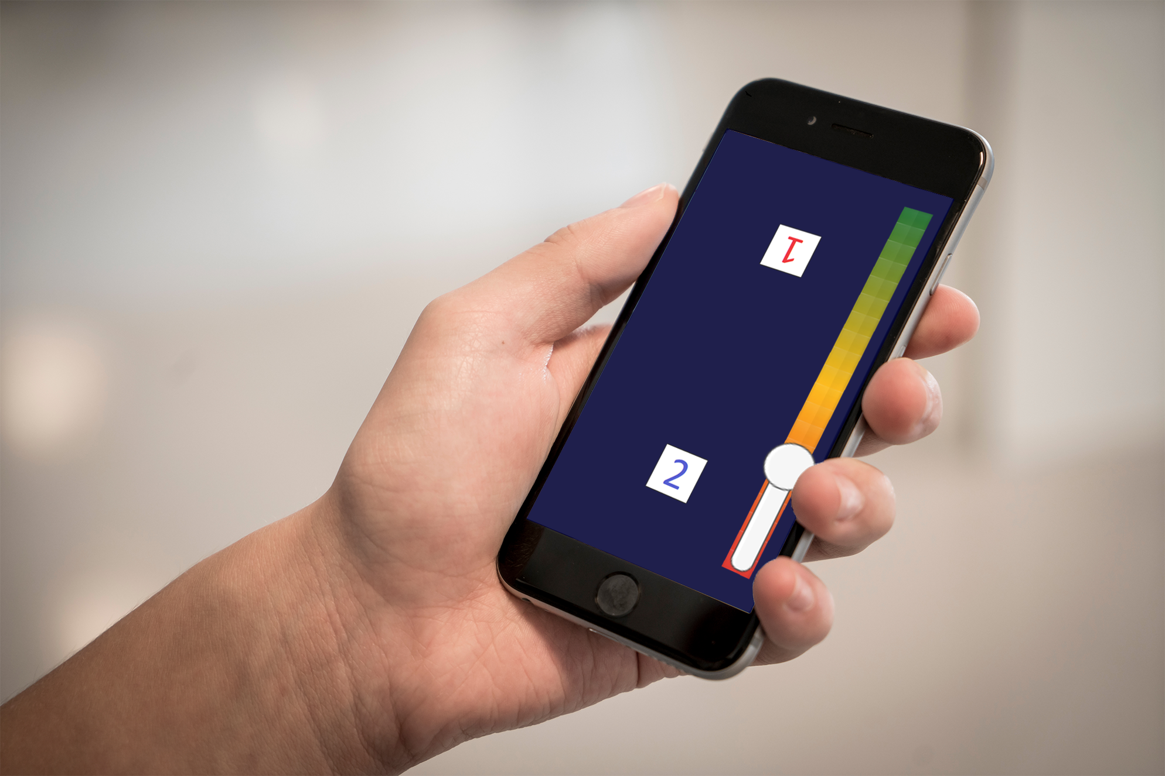
What does the player do?
Notes:
Tom

Slide 6
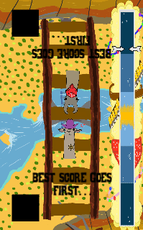
Latest Alpha Build
Most accurate tap wins first turn
Notes:
Tom

Slide 7
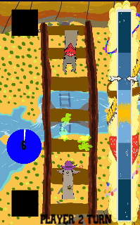
Latest Alpha Build
Timed tap yields greater effect
Win condition
Notes:
Tom

Slide 8
Theme
Why llama bois?
Light-hearted and comedic twist
Smashing through first-level consciousness
Natural and intuitive controls
Notes:
Dan

Slide 9
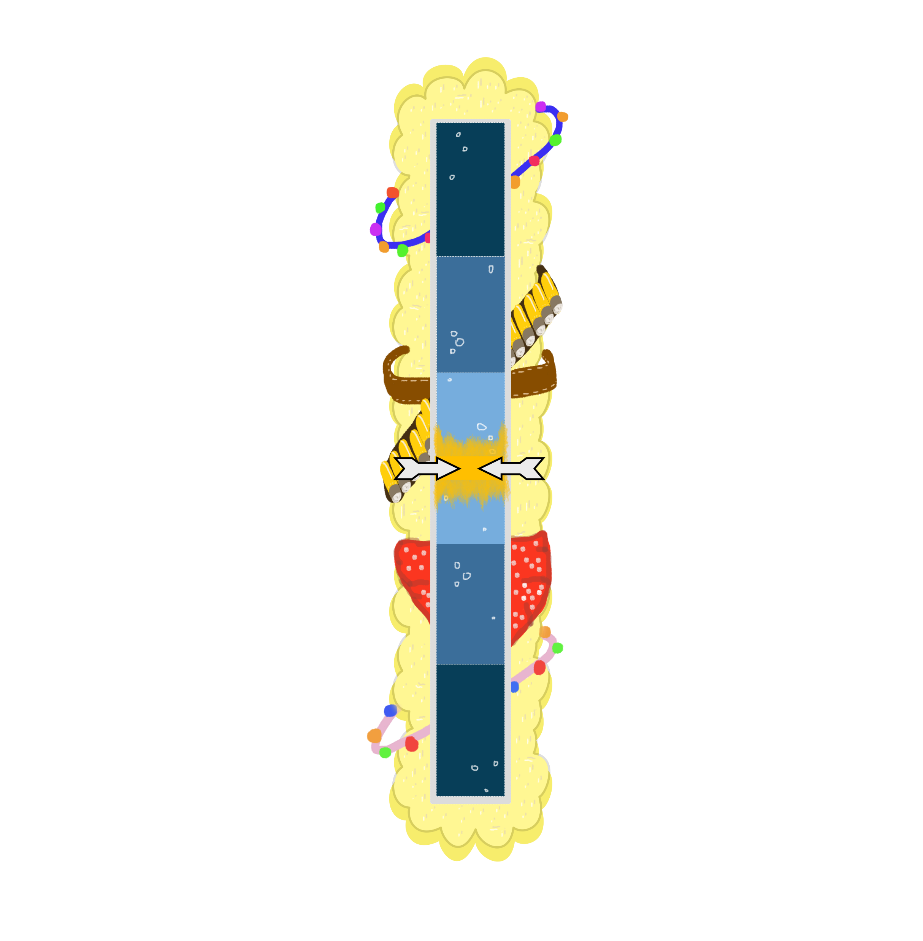

Art – Power Meter
Notes:
Dan

Slide 10

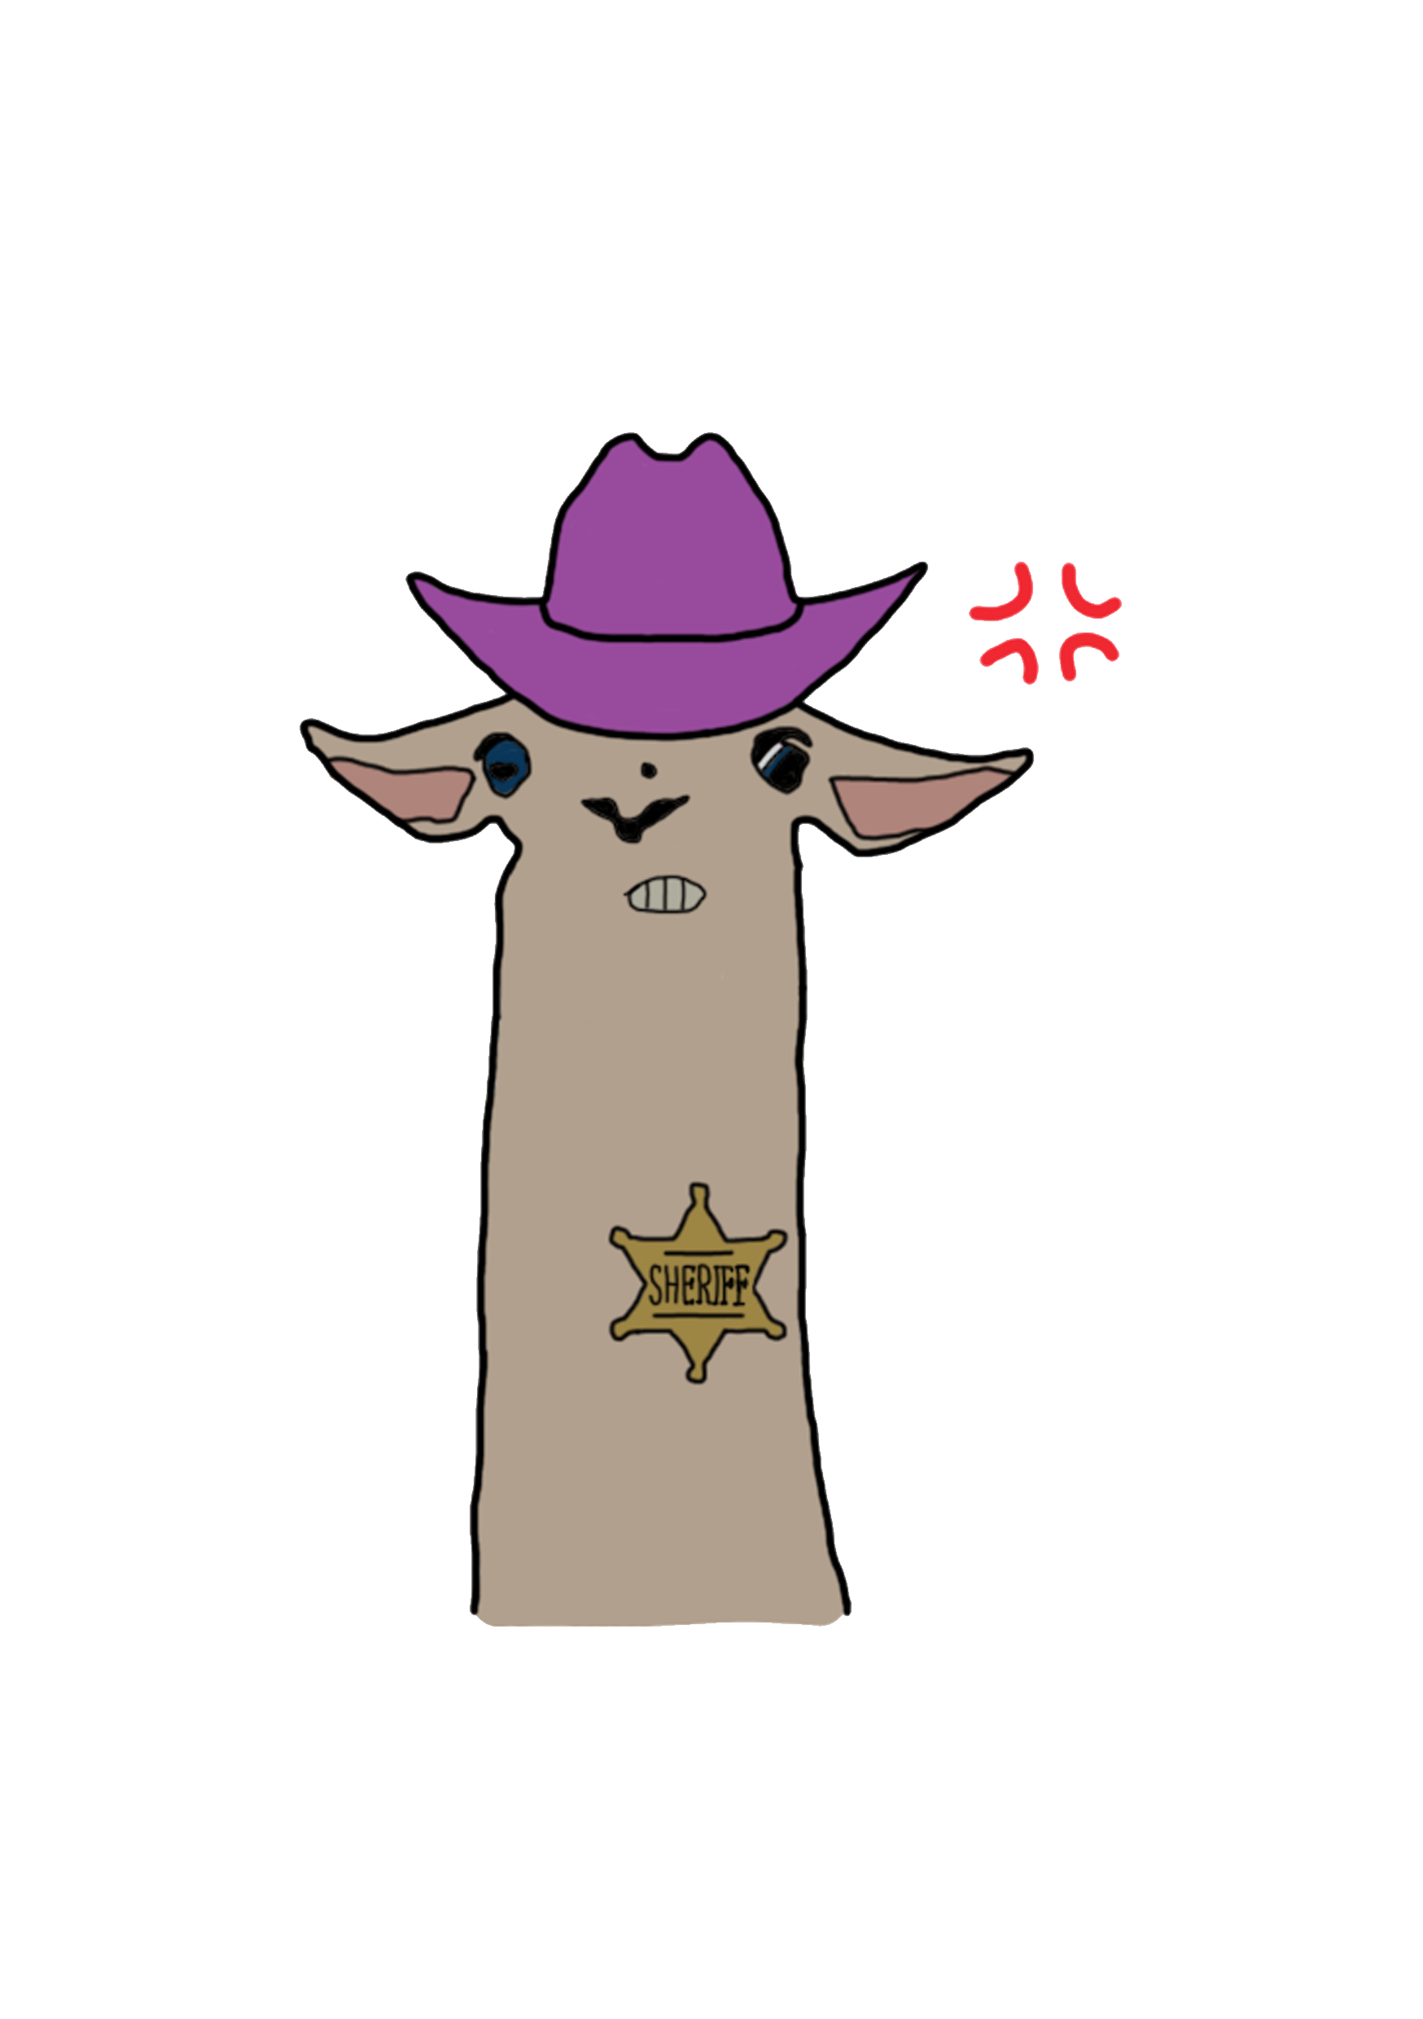


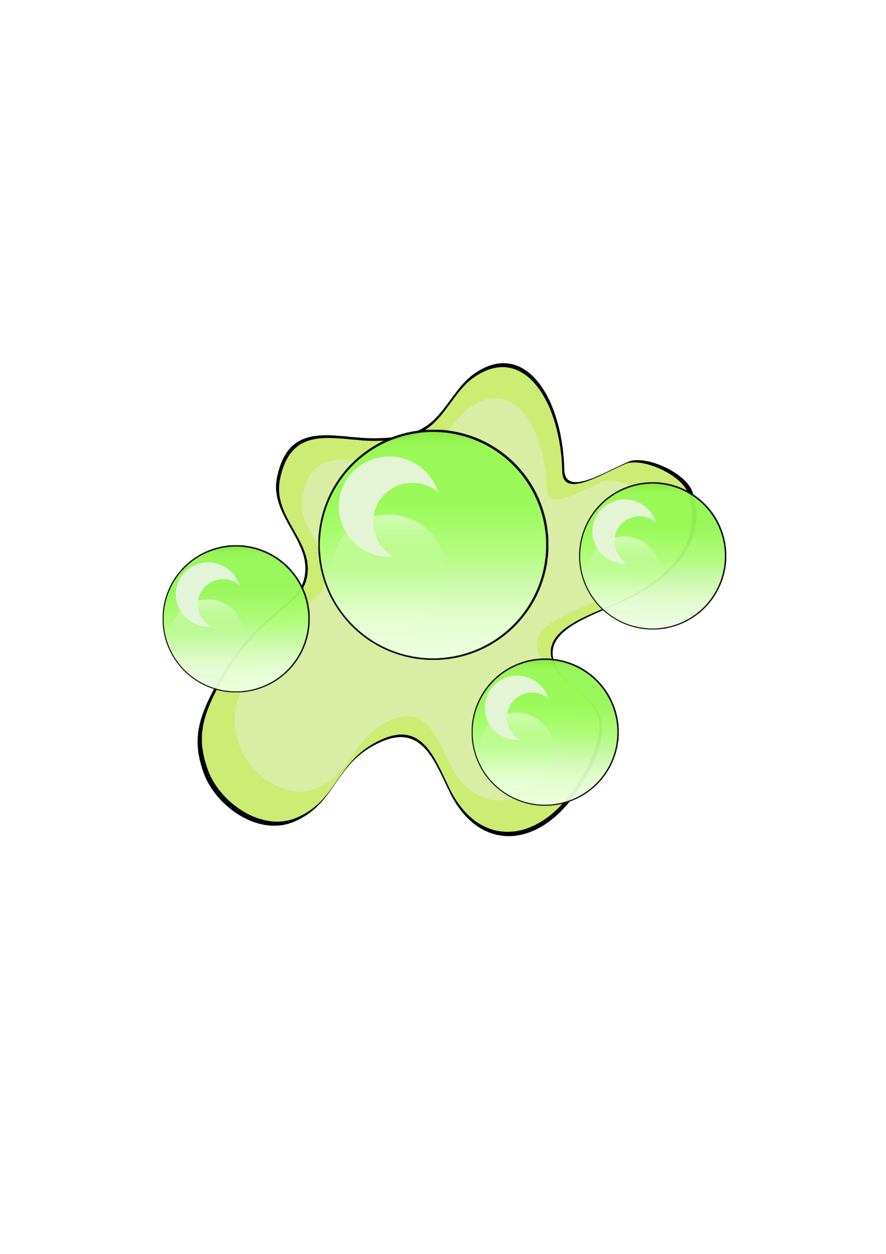

Art – Character Design
Notes:
Jack

Slide 11
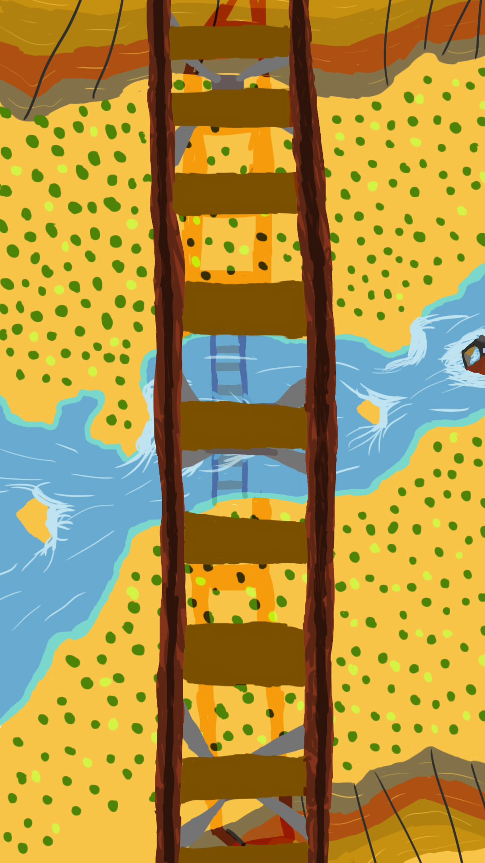
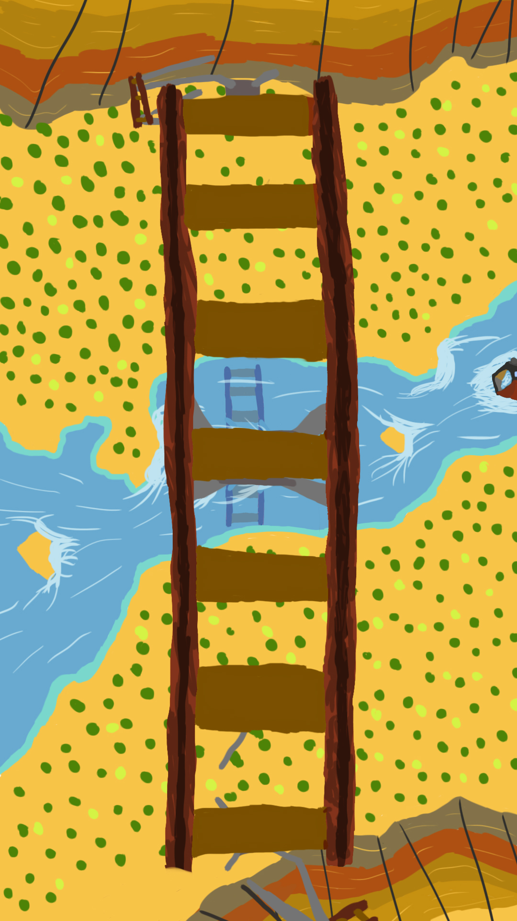
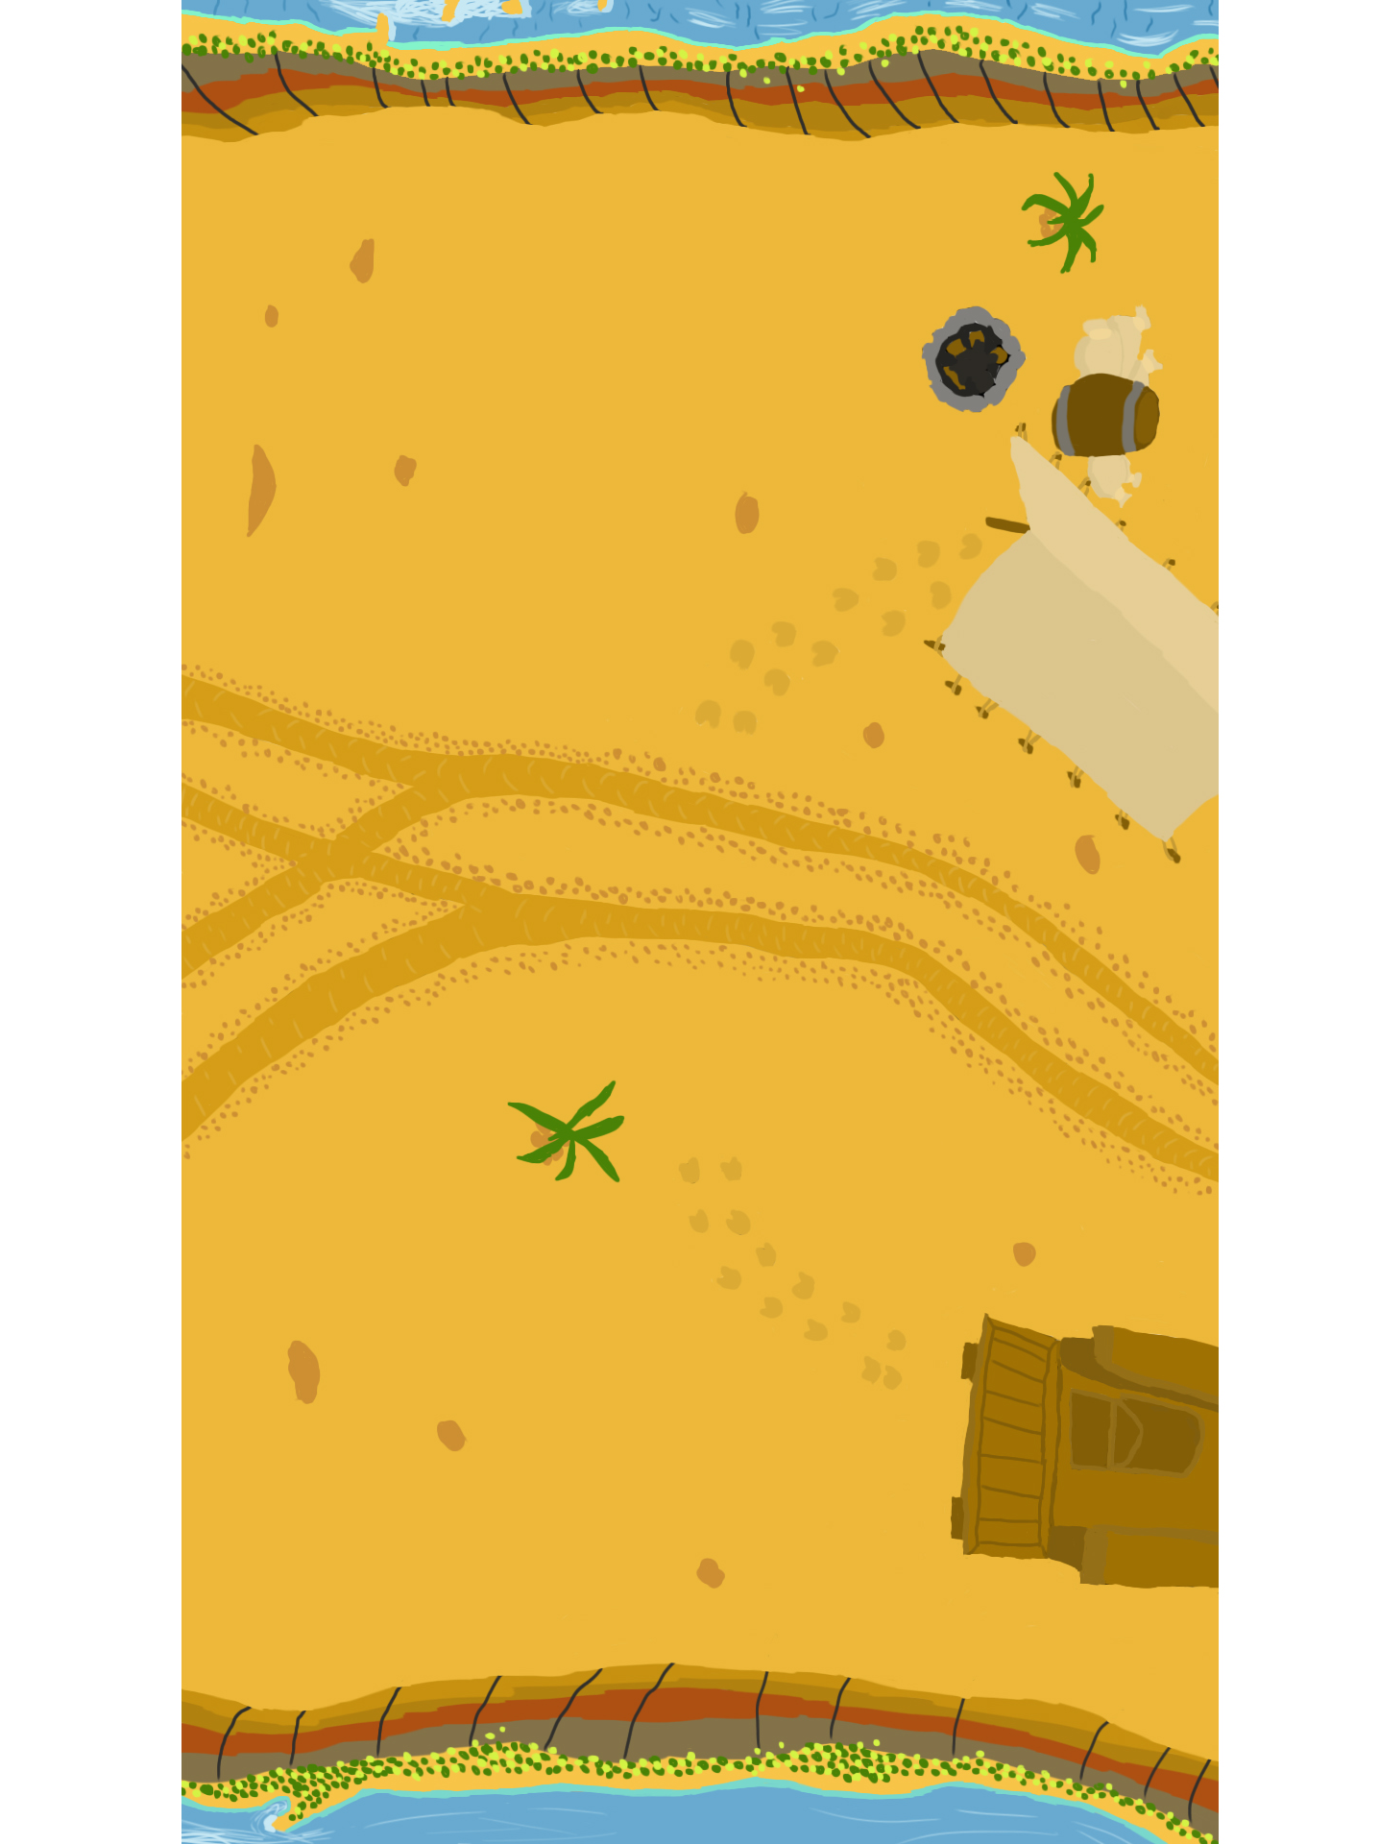
Art – Background Design
Notes:
Jack

Slide 12
Playtesting and the Iterative Cycle
“Playtesting is the most important part of the game development process” – Mike Ambinder, Senior Experimental Psychologist, Valve
Notes:
Fraser

Slide 13
Where’s the fun? – 4 Keys 2 Fun
People fun
Amusement from Competition and Cooperation
Hard fun
Challenge; Fiero from achieving a difficult goal
Notes:
Fraser

Slide 14

Notes:
all

